Slide 1
A Tabulated Vector
Approach For Log-Based Anomaly Detection
Robert Gutierrez, 2LT
AFIT/ENS
Advisor: Dr. Kenneth Bauer
Committee Member: Dr. Trevor Bihl
Committee Member: LTC Cade Saie
Committee Member: Dr. Bradley Boehmke
13 February 2017

Slide 2
Overview
Introduction
Literature Review
Dataset Description
Methodology-Case Study
Conclusion
Shiny App Demonstration

Slide 3
Motivation
Let me paint you a picture of the current tempo that ARCYBER analysts currently face
  Textbook big data problem:
    Unstructured, high volume, high velocity (Bihl et al. 2016)
  2 min snapshot → over 50,000 observations
Analysts seek to find one or more genuine threats but are limited by the number of observations one can sort through per day
Need a faster technique to identify authentic anomalies
  At least 3 days to investigate a potential anomaly (many false negatives)
Notes:
Idea:
Print multiple pages of full sheets of data
Ask audience member to search for bolded values
Within the next 10 seconds, hand them another sheet
And another

Slide 4
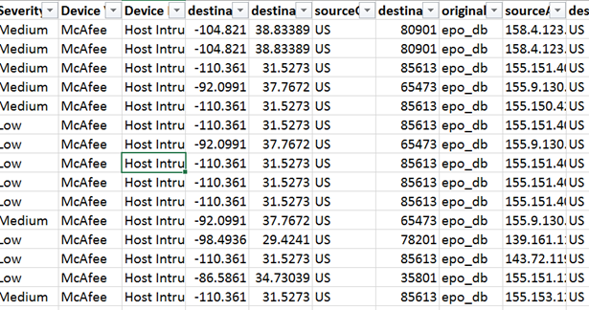
Current Practice
Manual data filtering
Data
Filter by column X
Filter by column Y
Filter by column Z
Interpret

Slide 5
Research Questions
Which techniques can narrow the search window for potential anomalies within network security device log files?
What data visualization methods can be leveraged with the above techniques to aid in the discovery of potential anomalies?
Can this methodology be developed into a web-based application that incorporates user driven input for investigative analysis?

Slide 6
Overview
Introduction
Literature Review
Dataset Description
Methodology-Case Study
Conclusion
Shiny App Demonstration

Slide 7
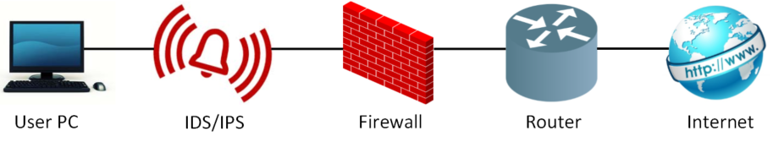
Literature Review
Cyber Network
Firewalls
  Blockades between an internal and external network
Intrusion Detection / Prevention Systems
  Monitor network traffic to detect imminent threats
  Generate an alert vs. attempt to thwart the attack
Based on a set of rules: signature based vs. anomaly based
Security devices generate a log file to record all triggered events
Most research focused on anomaly detection at the device/software level
Limited exploration on log file threat detection techniques

Slide 8
Key Papers
Outlier Detection
  Look for statistical outliers from the rest of the data
  Denning first proposed intrusion detection in cyber security devices in 1987
  Zhang & Zulkernine proposed the use of random forests in 2006
Event Correlation
  Abad et al. state that an intrusion leaves multiple signs of its presence in 2003
  Grimalia et al. use distributed event correlation to identify related intrusions in 2011
Dynamic Rule Creation
  Breier and Branišová build an anomaly profile by splitting data into time blocks in 2015
Principal Components Analysis
  Shyu et al. proposed a PCA based classifier for detection in 2003
Feature Vector Creations
  Winding et al. developed feature vectors that count the # of occurrences for unique values in a set of variables in 2006

Slide 9
Overview
Introduction
Literature Review
Dataset Description
Methodology-Case Study
Conclusion
Shiny App Demonstration

Slide 10
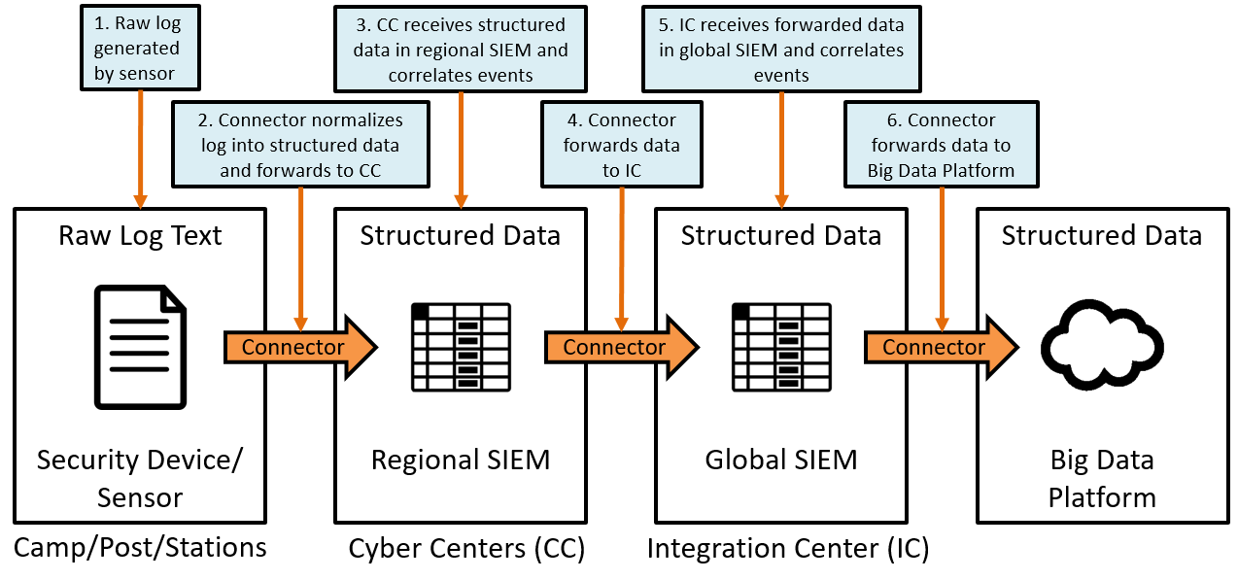
ARCYBER Data Capture
Adapted from the Army Sensor Event Flow and Schema (August 2016)

Slide 11
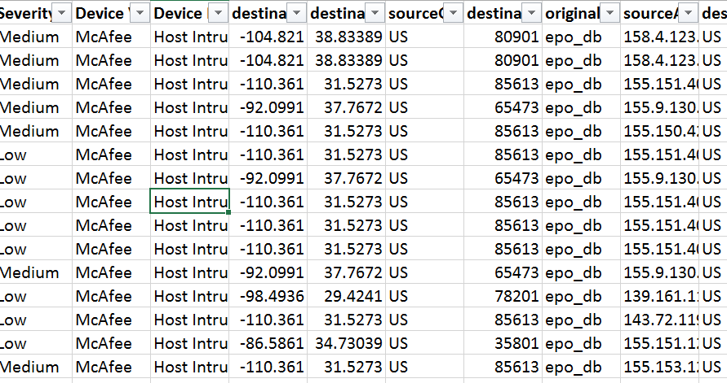
Representative Dataset
Output generated from big data platform that aggregates network security device log files
  2 min of data
    39,304 observations, ~240 fields
Unsupervised data
  No understanding of a normal observation or anomaly

Slide 12
Data Pre-processing
Consulted with Sponsor:
  9 fields retained
  Fields chosen for 2 reasons:
    Based on their commonality with log files from multiple security devices
    Ease of demonstrating the proposed methodology
      No text mining
Field Name | Description
Device Vendor | Company who made the device
Device Product | Name of the security device
Source Address | IP address of the source
Destination Address | IP address of the destination
Transport Protocol | Transport protocol used
Bytes In | Number of bytes transferred in
Bytes Out | Number of bytes transferred out
Category Outcome | Action taken by the device
ad.SCN | Country of the source IP address

Slide 13
Overview
Introduction
Literature Review
Dataset Description
Methodology-Case Study
Conclusion
Shiny App Demonstration

Slide 14
Current vs Future: Notional Diagrams
Kibana / Decision Hierarchy
Our Proposed Methodology
Data
1) Select columns of interest
Data
Filter by column X
Sample
2) Block data by time
Block 1
Filter by column Y
Block 2
Block 3
3) Converts blocks into state vectors
Filter by column Z
4) Multivariate analysis on state vector to find outliers
State Vectors
Outliers
Investigate
anomalous
blocks
Interpret
Going directly to a specialist doctor
*based on past experiences
Going in for a general physical
*need to diagnose symptoms
Notes:
ARCYBER current work
1) analysts build their own decision hierarchy based on expert knowledge from previous exploitations
2) may not retain time aspect as observations that fit filters could be anywhere
Our work
Blocks of interest are time regional
Outlier detection allows for investigative filtering inside the identified block

Slide 15
Approach
Present our methodology through a case study using unclassified data
The methodology will be represented as a flow diagram built incrementally through 5 subsections

Slide 16
Methodology Breakdown
Big Data Platform
Data
Pre-processing
Block
Creation
State Vector
Creation
Multi-collinearity
Adjustment
Pre-Processing
Statistical Methods
Graphical Analytics
Across Block Analytics
IP Network Graph
Histogram
Matrix
Factor Analysis Heatmap
Factor Analysis Score Plots
Histograms
Within Block Analytics

Slide 17
Pre-Processing
Big Data Platform
Data
Pre-processing
Block
Creation

Slide 18
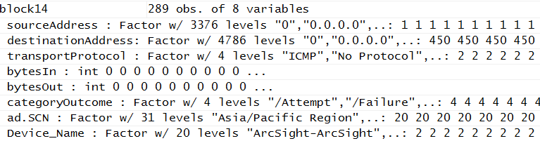
Data Pre-Processing / Block Creation
Data Pre-Processing
  Set NA values to zero
  Select variables of interest
    Device, Source/Dest IP, Protocol, bytes In/Out, Outcome, Location
  Create new variable
    Device_Name – connect device vendor and device product
Create Blocks
  Chosen to be of equal length (can be specified to desired length)
    136 blocks, 289 observations per block
  Created from reduced dataset
  Time sequenced
    No overlaps
  Non-numeric col → Factor

Slide 19
Methodology-Case Study
Big Data Platform
Data
Pre-processing
Block
Creation
State Vector
Creation

Slide 20
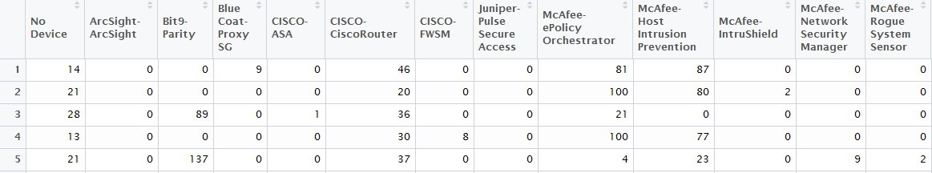
State Vector Creation
Field A | Field B
X | 1
Y | 0
Z | 3
X | 2
Y | 2
Y | 1
Z | 2
Z | 0
Y | 4
X
Z
B
Y
Block 1
2
4
3
15
Block 1
Notes:
Provides descriptive statistics for each block
Turns a contingency table into a vector by listing all factor levels with a count of occurrences for each
Takes the sum of numeric fields
List the count of occurrences for the top 10 source/destination IPs
Aggregate state vectors into a single data matrix

Slide 21
Methodology-Case Study
Big Data Platform
Data
Pre-processing
Block
Creation
State Vector
Creation
Multi-collinearity
Adjustment

Slide 22
Multicollinearity Adjustment
ISSUE: Sparsity of the matrix leads to multicollinearity
Remove columns whose variance is close to zero
σ²_{col} ≤ 0 + Δ₁, where Δ₁ = 0.1
Remove columns that are a linear combination of another column
findLinearCombos() → QR decomposition
Remove columns with high correlation values
r_{col} ≤ 1 – Δ₂, where Δ₂ = 0.05
*Order of these steps results in 1-2 column difference (53-55)
**Does not affect analysis

Slide 23
Methodology-Case Study
Big Data Platform
Data
Pre-processing
Block
Creation
State Vector
Creation
Multi-collinearity
Adjustment
Pre-Processing
Statistical Methods

Slide 24
Statistical Methods
Quantitative Methods
Mahalanobis Distance
Factor Analysis
  Dimensionality Assessment
  IFS
Qualitative Methods
Histogram Matrix
Heatmaps
Network Graphs

Slide 25
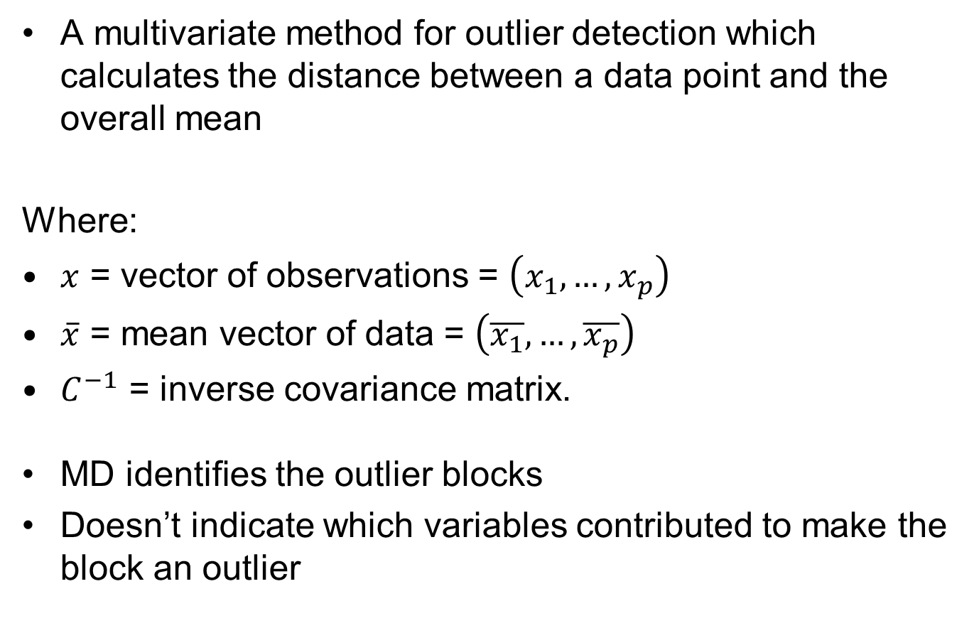

Mahalanobis Distance
A multivariate method for outlier detection which calculates the distance between a data point and the overall mean
Where:
$x$ = vector of observations = $\left(x_{1},…,x_{p}\right)$
$\overline{x}$ = mean vector of data = $\left(\overline{x_{1}},…,\overline{x_{p}}\right)$
$C^{−1}$ = inverse covariance matrix.
MD identifies the outlier blocks
Doesn’t indicate which variables contributed to make the block an outlier
$$MD= \sqrt{{\left(x−\overline{x}\right)}^{T}C^{−1}\left(x−\overline{x}\right)}$$
Notes:
Allows the variable to be weighted by their variability. In contrast to Euclidean distance, that assumes all variables vary equally

Slide 26
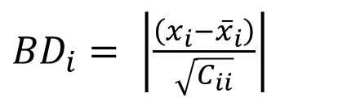
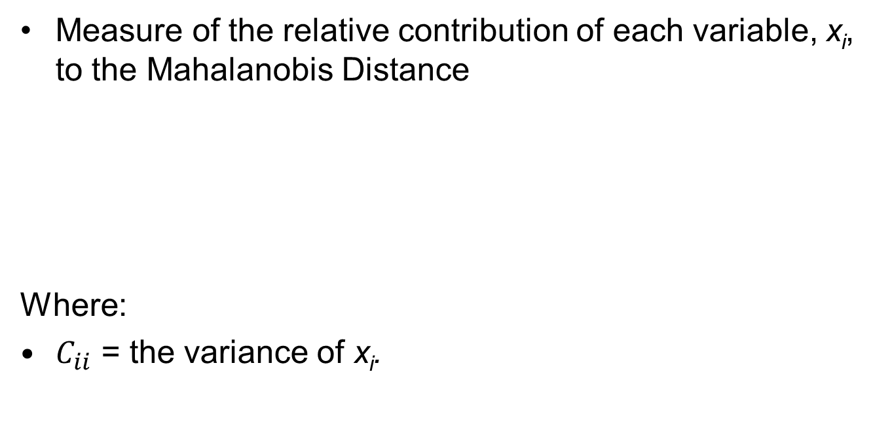
Breakdown Distance: Our Heuristic
Measure of the relative contribution of each variable, x_{i}, to the Mahalanobis Distance
Where:
$C_{ii}$ = the variance of x_{i}.
${BD}_{i}= \left|\frac{\left(x_{i}−{\overline{x}}_{i}\right)}{\sqrt{C_{ii}}}\right|$

Slide 27
Factor Analysis
Factor Analysis
  Explain the structure of the data by relating the correlations between variables through a set of factors
  Dimensionality Assessment
    Necessary to retain the factors that account for the most variation in the data
  Varimax – orthogonal rotation that maximizes the variance of the squared factor loadings → provides easier interpretation
  Produces a correlation heatmap of the factor loadings
  Provides factor scores for outlier detection
Index of Factorial Simplicity (IFS²)
  Assess quality of factor analysis solution
  Used to decide which loadings & scores to use: original or rotated
Notes:
Orthogonal rotation assumes independence between the factors while oblique rotations allow the factors to correlate

Slide 28
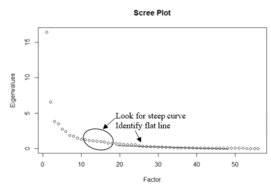
Dimensionality Assessment
Kaiser’s Criterion
  Retain factors whose eigenvalues are greater than 1.0
Cattell’s Scree Test
  Graph the eigenvalues and retain those that form the steep curve

Slide 29
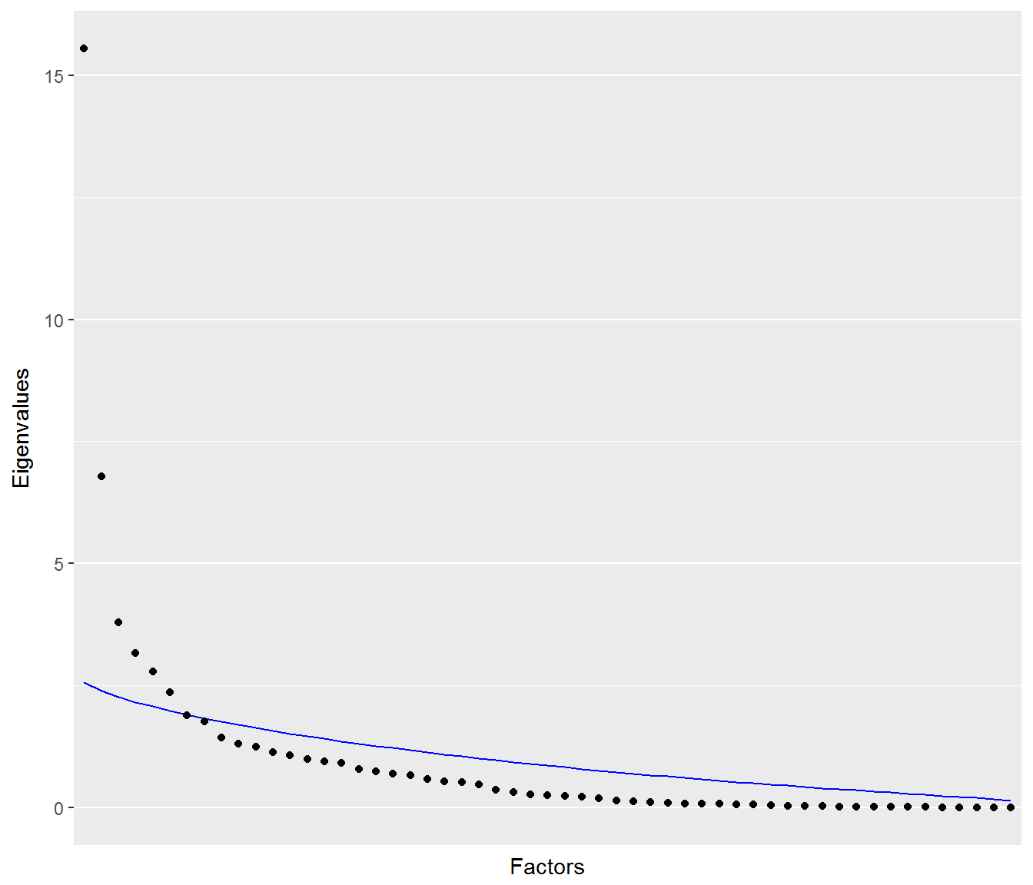
Dimensionality Assessment
Horn’s Parallel Analysis
  Monte Carlo simulation of n x p matrices drawn from a standard normal probability distribution
  Extract eigenvalues from the correlation matrices
  Sort and average the eigenvalues
Retained Factors
  Retain factors whose eigenvalues from the data are greater than those generated from Horn’s Parallel Analysis
  For this research, we retained 6 factors
Notes:
The eigenvalues should model the blue trend line if they are unstructured (i.e. everything is independent)
Since there is structure, we accept the eigenvalues above the trend line and retain those components

Slide 30
Methodology-Case Study
Big Data Platform
Data
Pre-processing
Block
Creation
State Vector
Creation
Multi-collinearity
Adjustment
Pre-Processing
Statistical Methods
Histogram
Matrix

Slide 31
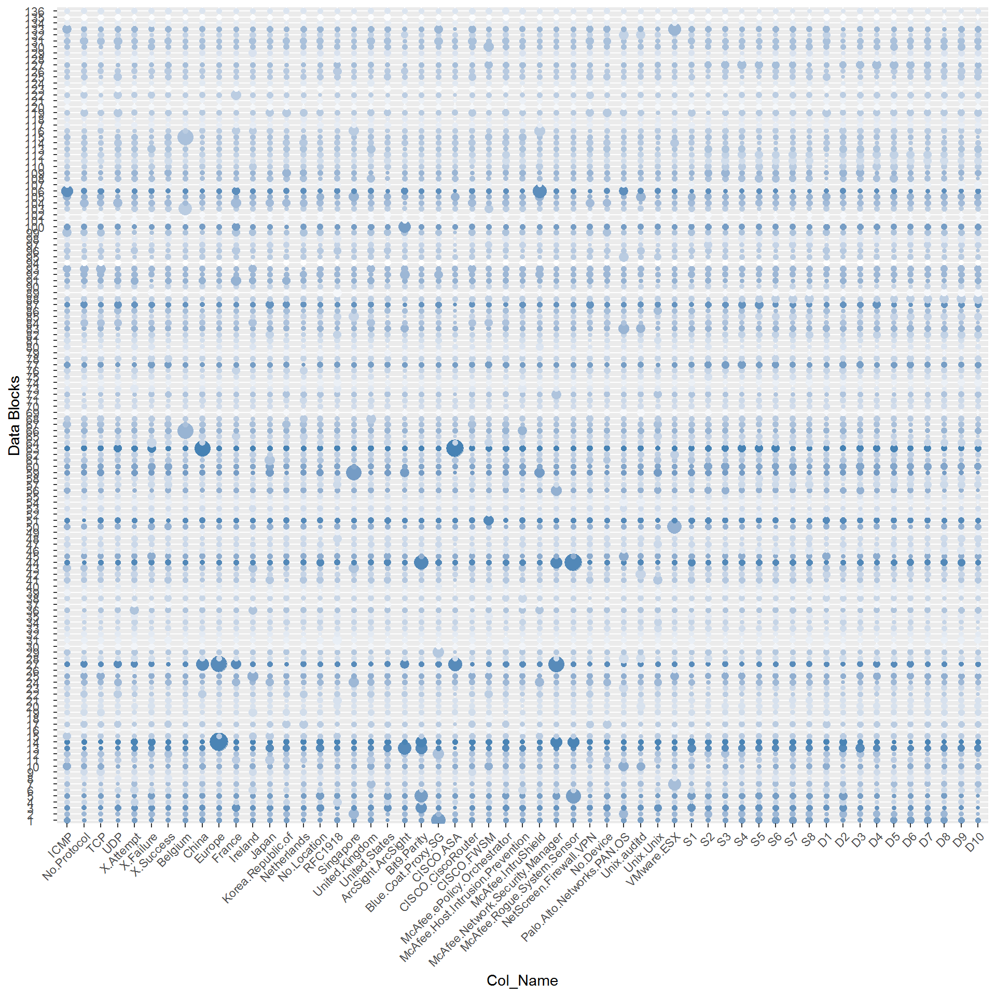
Histogram Matrix: All Blocks

Slide 32
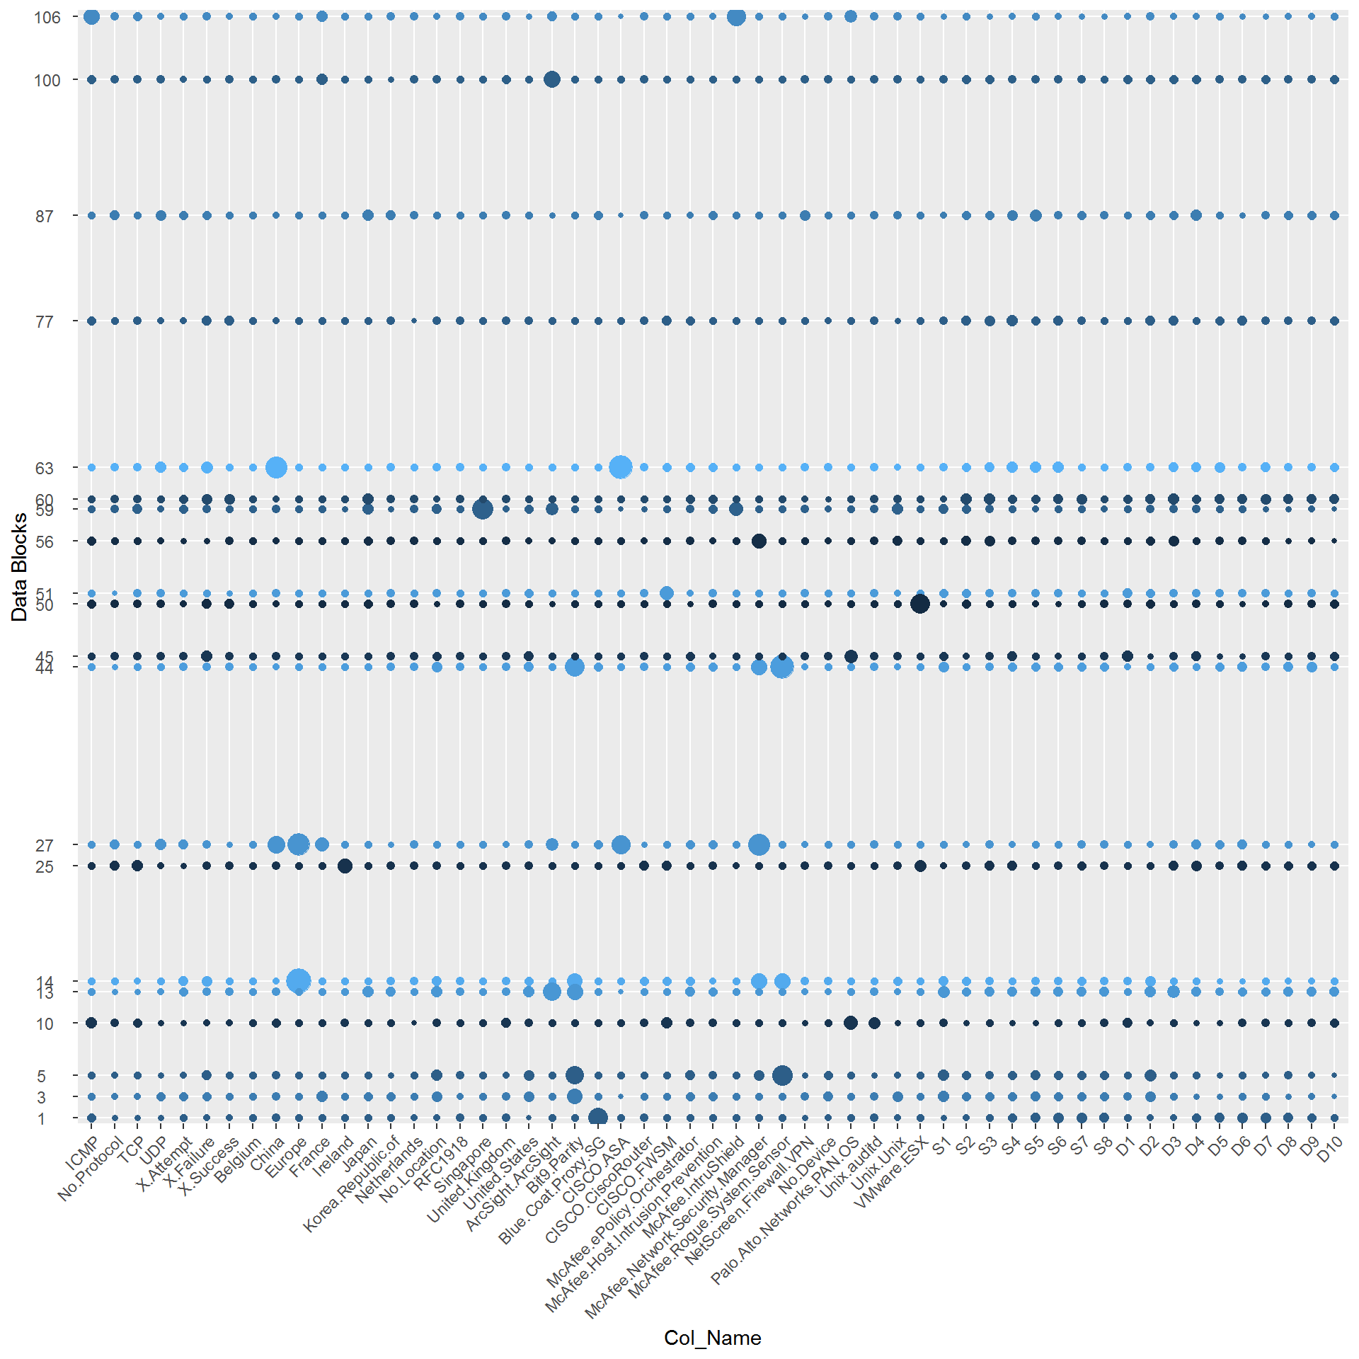
Histogram Matrix: Top 20

Slide 33
Methodology-Case Study
Big Data Platform
Data
Pre-processing
Block
Creation
State Vector
Creation
Multi-collinearity
Adjustment
Pre-Processing
Statistical Methods
Histogram
Matrix
Histograms
Within Block Analytics

Slide 34
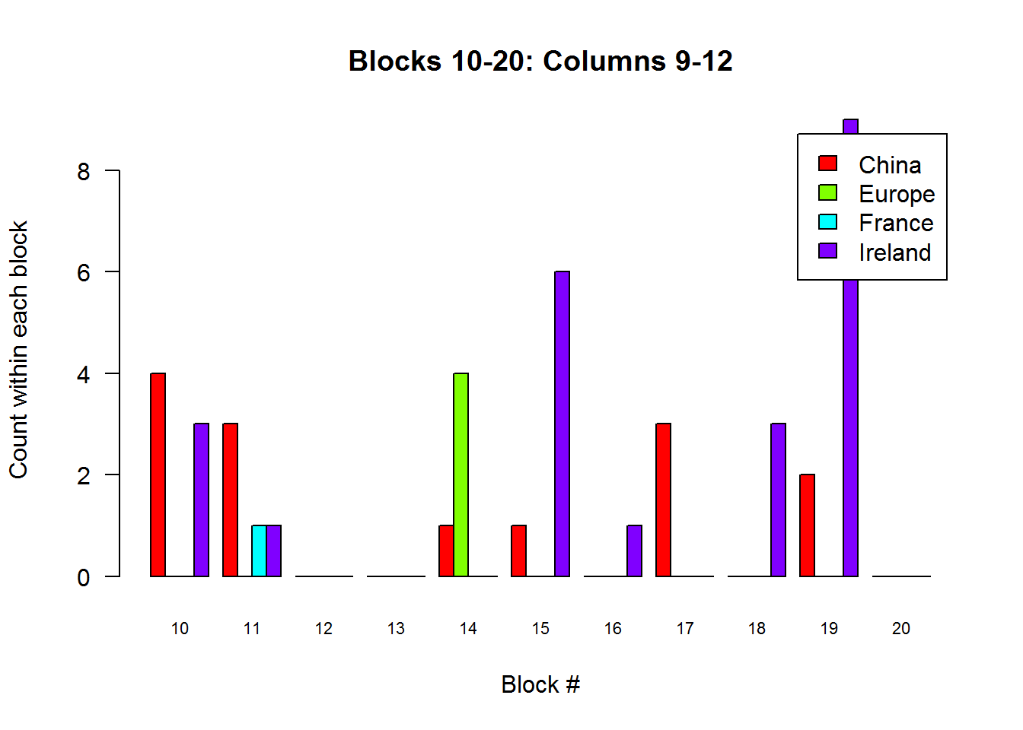
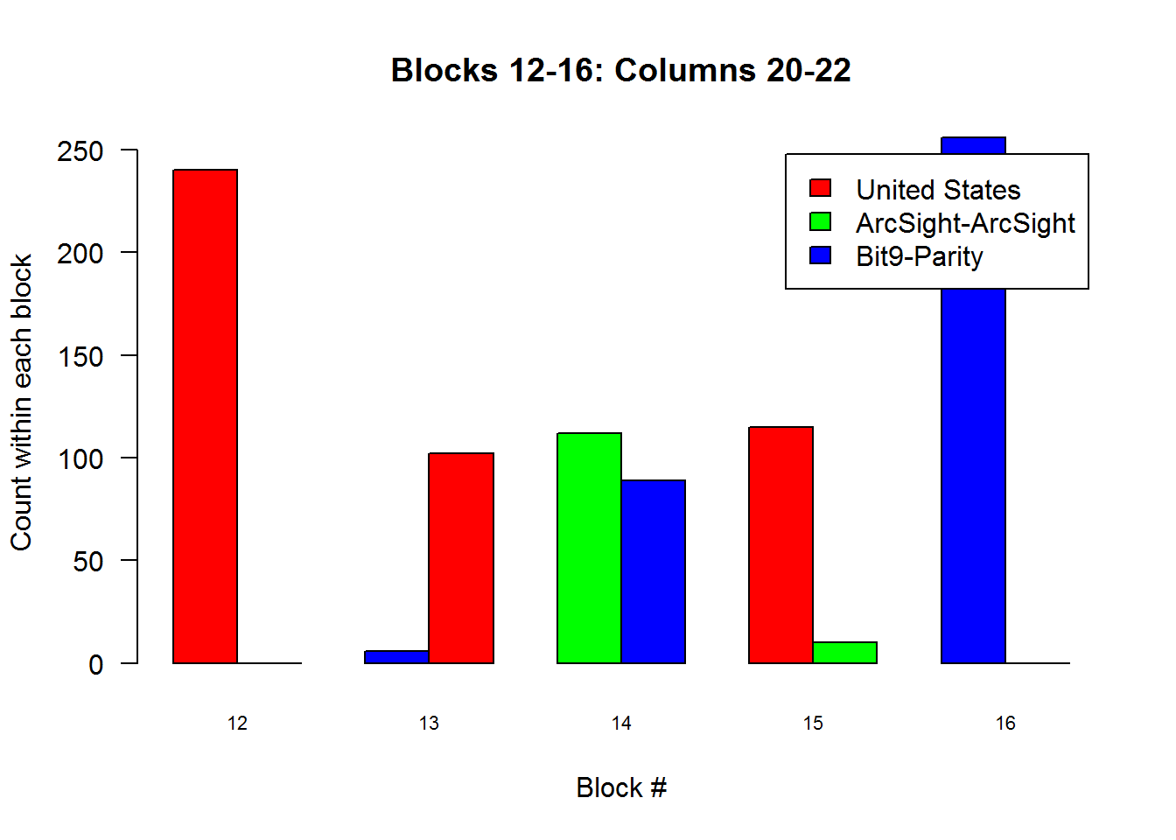
Histograms
Looking at columns 9-12, we see a large dissimilarity in the number of observations from Europe in Block 14 relative to the neighboring blocks
Looking at columns 20-22, we see another dissimilarity in the number of observations from ArcSight in Block 14 relative to the neighboring blocks

Slide 35
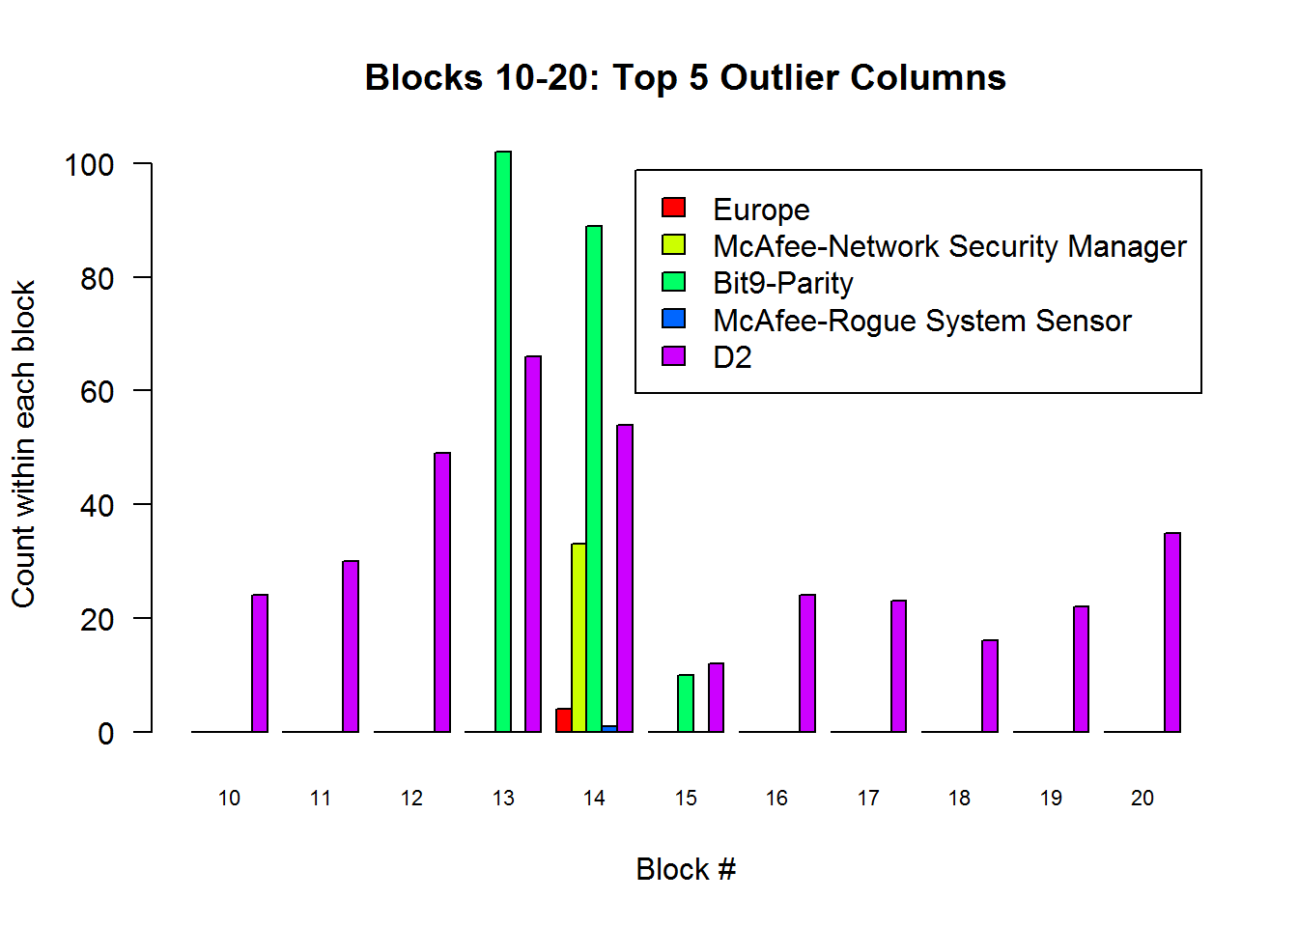
Outlier Example (Block 14)
Leads to the suggestion for a larger block size to encompass blocks 13 and 14
The destination IP 137.95.41.106 is labeled as D2 for block 14 in the State Vector

Slide 36
Methodology-Case Study
Big Data Platform
Data
Pre-processing
Block
Creation
State Vector
Creation
Multi-collinearity
Adjustment
Pre-Processing
Statistical Methods
Across Block Analytics
Histogram
Matrix
Factor Analysis Heatmap
Factor Analysis Score Plots
Histograms
Within Block Analytics

Slide 37
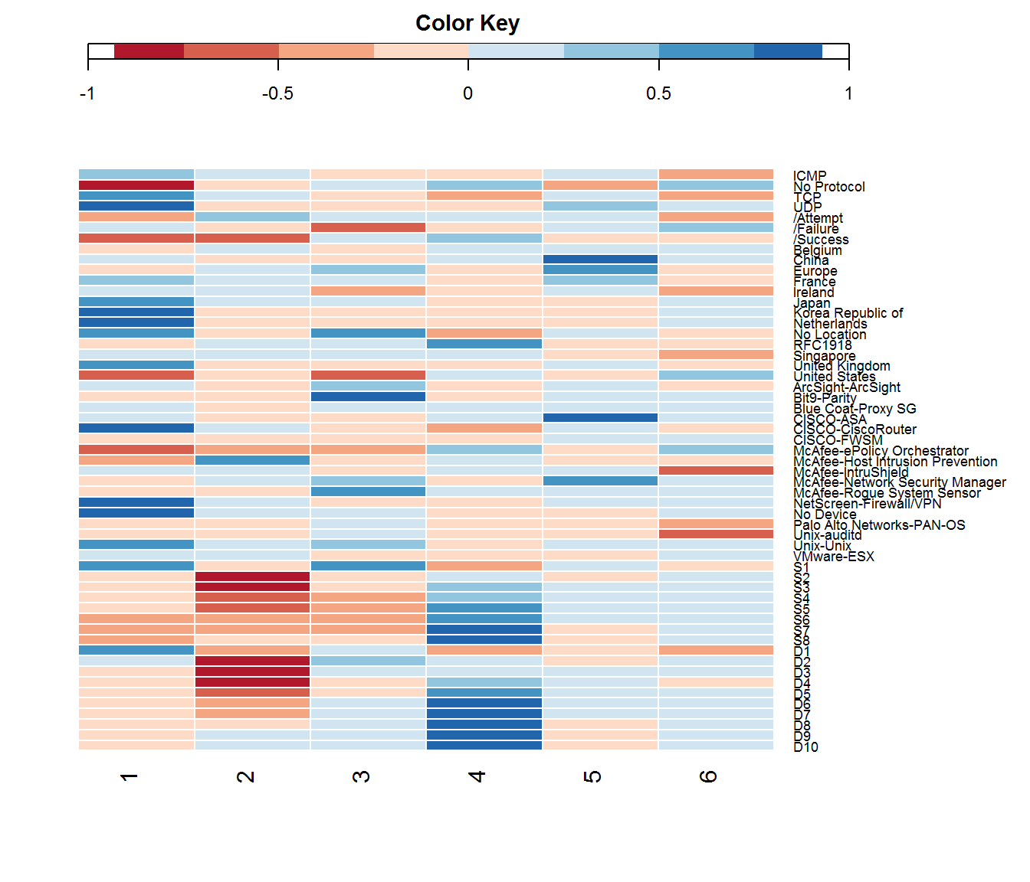
Visual Analytics: Heatmap
Each column has a correlation relationship with the variables along the right side
Dark blue: values increase
Dark red: values decrease
Ex. Column 5 (Blue)
  China
  Europe
  CISCO-ASA
  McAfee-NSM
Notes:
Important to remember that this is looking at the entire reduced feature vector and provides “trends” found through correlation as an output of factor analysis

Slide 38
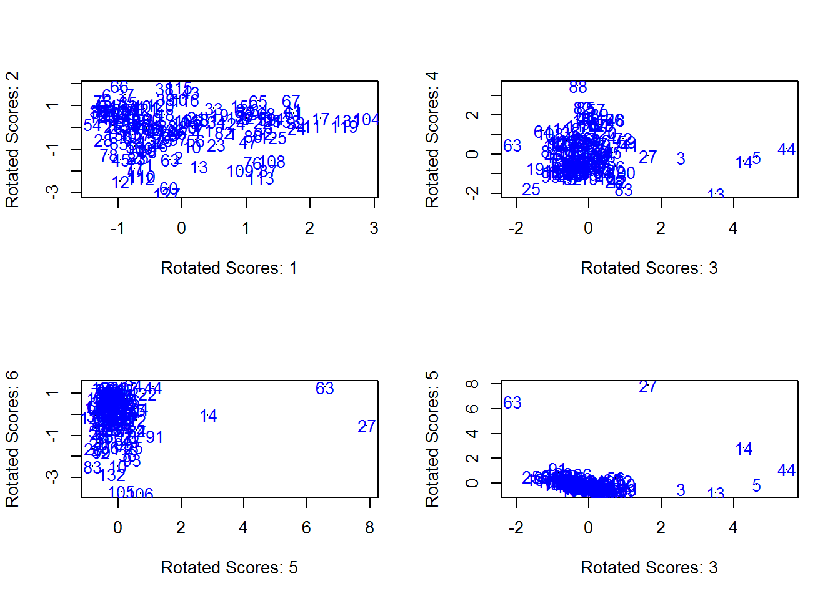
Factor Score Plots
Notes:
The circled blocks are identified as outliers, consistent with the top 10 blocks found in Mahalanobis distance

Slide 39
Methodology-Case Study
Big Data Platform
Data
Pre-processing
Block
Creation
State Vector
Creation
Multi-collinearity
Adjustment
Pre-Processing
Statistical Methods
Graphical Analytics
Across Block Analytics
IP Network Graph
Histogram
Matrix
Factor Analysis Heatmap
Factor Analysis Score Plots
Histograms
Within Block Analytics

Slide 40
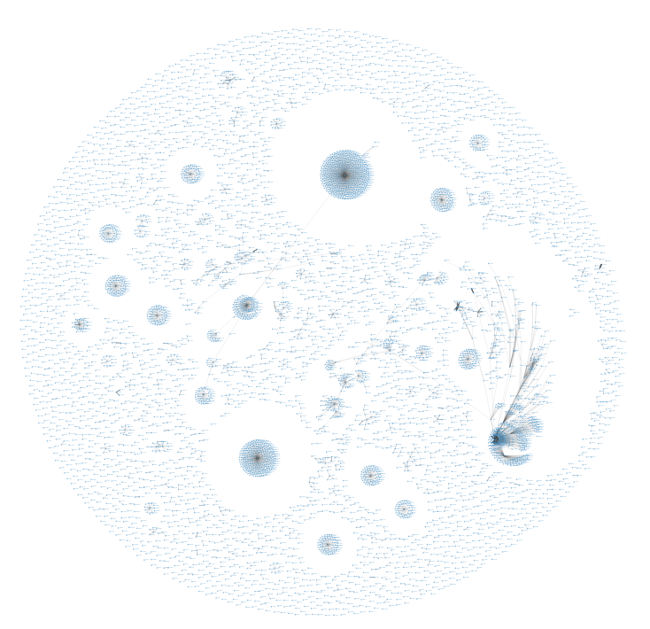
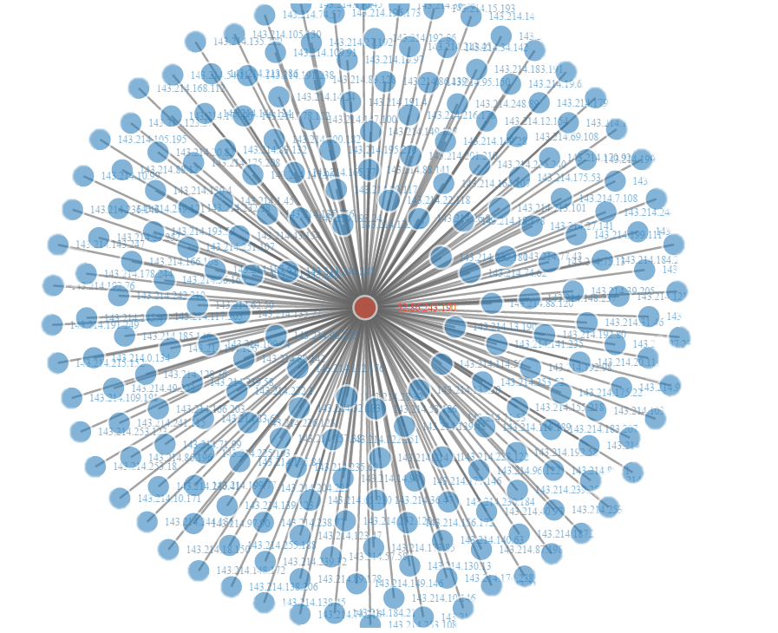
IP Network Graph
Notes:
We can use Network graphs such as this one to get an idea of what is going on during a snapshot of time. Using this, an analyst can zoom in and identify the focal node (source IP) as a starting point for investigative analysis.

Slide 41
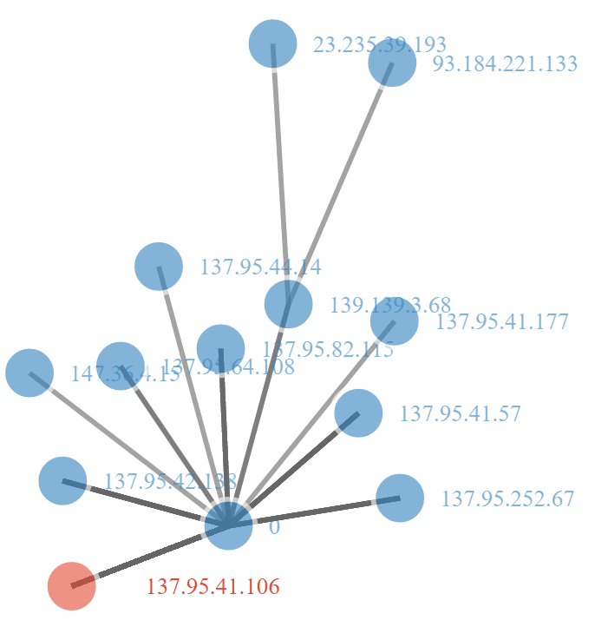
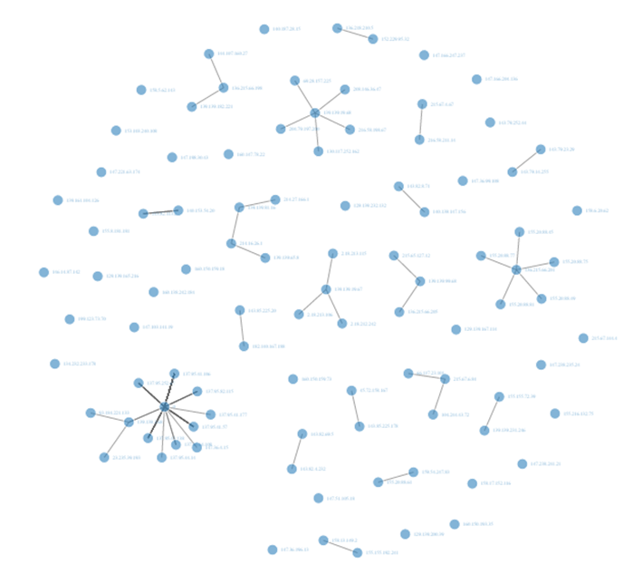
Outlier Example (Block 14)
Block 14 Network Graph
Coincidentally, the destination IP labeled as D2 for block 14 in the State Vector is an outlier and found in this large cluster
Source not identified but likely to be performing a network scan on 137.95.XXX.XXX

Slide 42
Conclusion
Using a State Vector approach, we developed a methodology to identify outlier time blocks for further investigation
  Methodology employs multivariate statistics as well as graphical methods
  Narrows the search window for ARCYBER analysts
Developed a heuristic for identifying the most important variables within a time block based on the breakdown distance which decomposes the Mahalanobis distance value for an outlier time block

Slide 43
Future Research
Variable selection
Factor Analysis Rotation Methods
  Oblique vs. Orthogonal
Block Size
More sophisticated unsupervised machine learning methods

Slide 44
5 Minute Break
We will now break for 5 minutes before we continue on with our Shiny App Demonstration

Slide 45
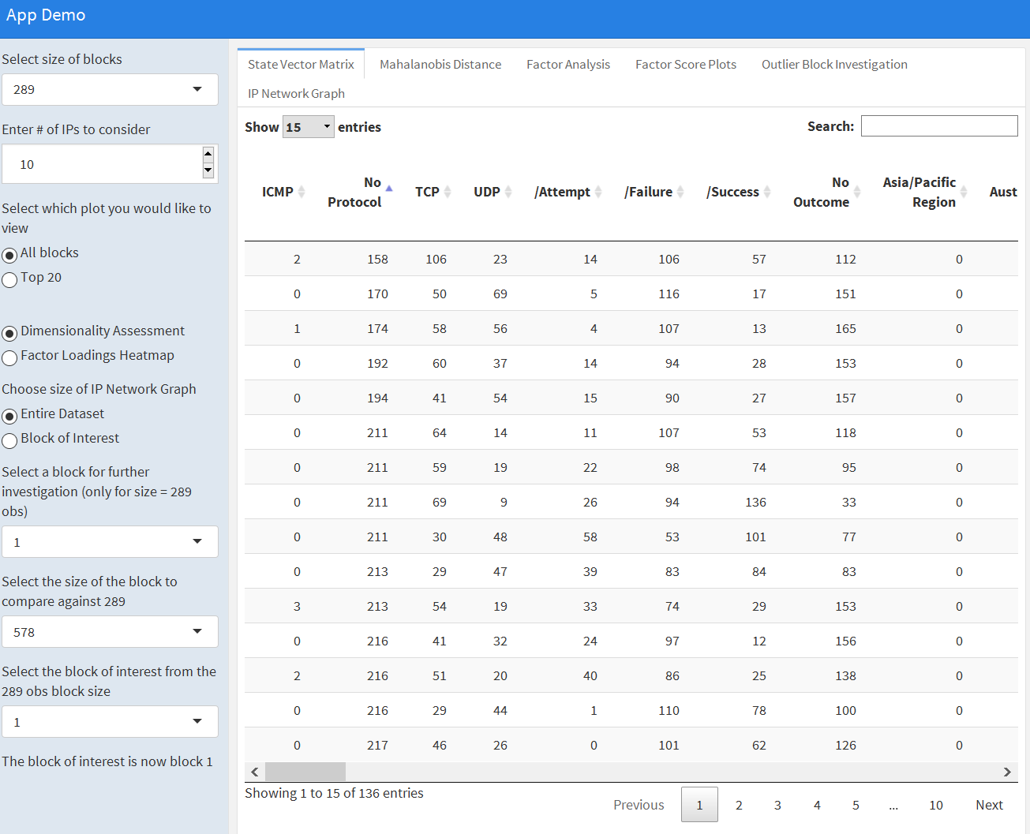
Shiny App Demonstration

Slide 46
anomalyDetection Package
To improve efficiency and streamline the process of shiny app development, we created a package that uses the functions in the table below to perform our methodology
Way ahead:
  Plan is to publish to CRAN
  Submit to Journal of Open Source Software for Publication
Function Name | Description
get_all_factors | Find all factor pairs for a given integer
tabulated_state_vector | Divides data into blocks and performs a contingency table to vector conversion
mc_adjust | Handles issues with multicollinearity
mahalanobis_distance | Calculates the distance between a data point and the mean vector
horns_curve | Find average eigenvalues for dimensionality assessment
principal_components | Reduce structure of data to
factor_analysis | Reduce structure of data to a set of factors
kaisers_index | Score used to assess factor analysis solution
bd_row | Finds contribution of each variable to the Mahalanobis distance in a given row

Slide 47
Questions?

Slide 48
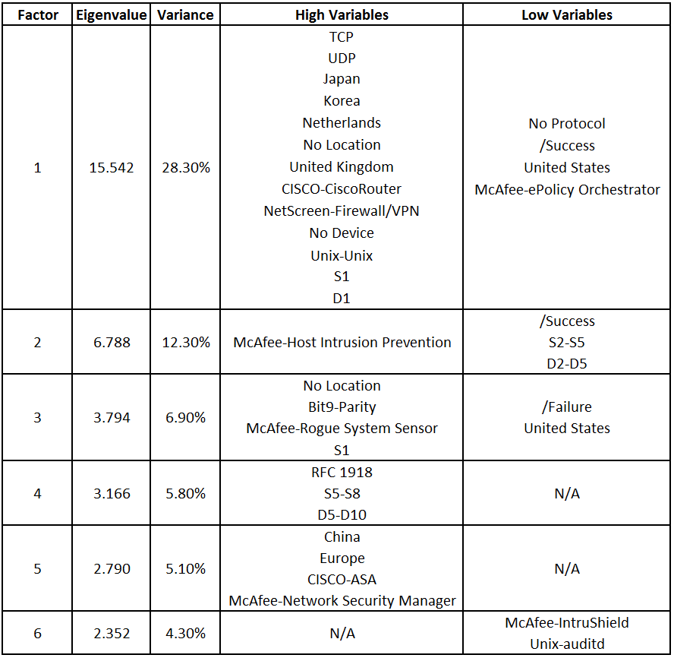
Backup 1: Factor Breakdown

Slide 49
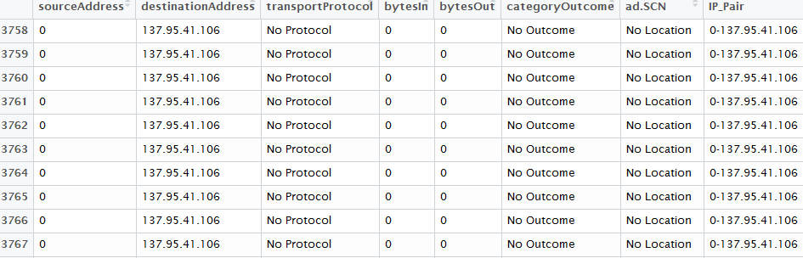
Outlier Example (Block 14)
Original Data (above)
State Vector (below)

Slide 50
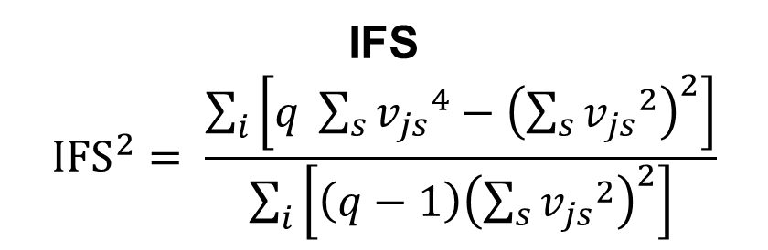
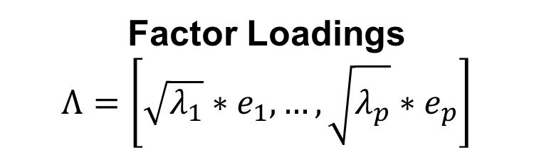


Factor Analysis Equations
Factor Analysis Model
$X= Λf+e$
IFS
$${IFS}^{2}= \frac{\sum_{i}{\left[q \sum_{s}{{v_{js}}^{4}−{\left(\sum_{s}{{v_{js}}^{2}}\right)}^{2}}\right]}}{\sum_{i}{\left[\left(q−1\right){\left(\sum_{s}{{v_{js}}^{2}}\right)}^{2}\right]}}$$
Factor Loadings
$$Λ=\left[\sqrt{λ_{1}}∗e_{1},…,\sqrt{λ_{p}}∗e_{p}\right]$$
IFS Level | Evaluation
In the 0.90s | Marvelous
In the 0.80s | Meritorious
In the 0.70s | Middling
In the 0.60s | Mediocre
In the 0.50s | Miserable
Below 0.50 | Unacceptable
Factor Scores
$\hat{f}= X_{s}R^{−1}Λ$

